Slide 2
Deploying Complex Open Source Workloads on Azure
2-732
Haishi Bai
SENIOR SDE, TED Services & Devices
Mahesh Thiagarajan
Senior Program Manager, Azure Compute
Brian Benz
Senior Technical Evangelist

Slide 3

Agenda
Azure Loves Open Source
Why Use OSS on Azure
Sample Scenarios

Slide 4
Azure Loves Open Source

Slide 5
In the past year…
150+ Standardization bodies
Azure Redis Cache
Azure Template
Windows containers
Open source CoreCLR
OPC
20% of Azure VM are Linux Machines
Marketplace
ASP.NET and OWIN
AMQP
Azure Search uses Elasticsearch
HDInsight runs on Linux
Docker integration
VM Depo

Slide 6


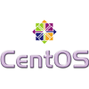
























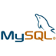



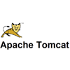



OSS on Azure

Slide 7










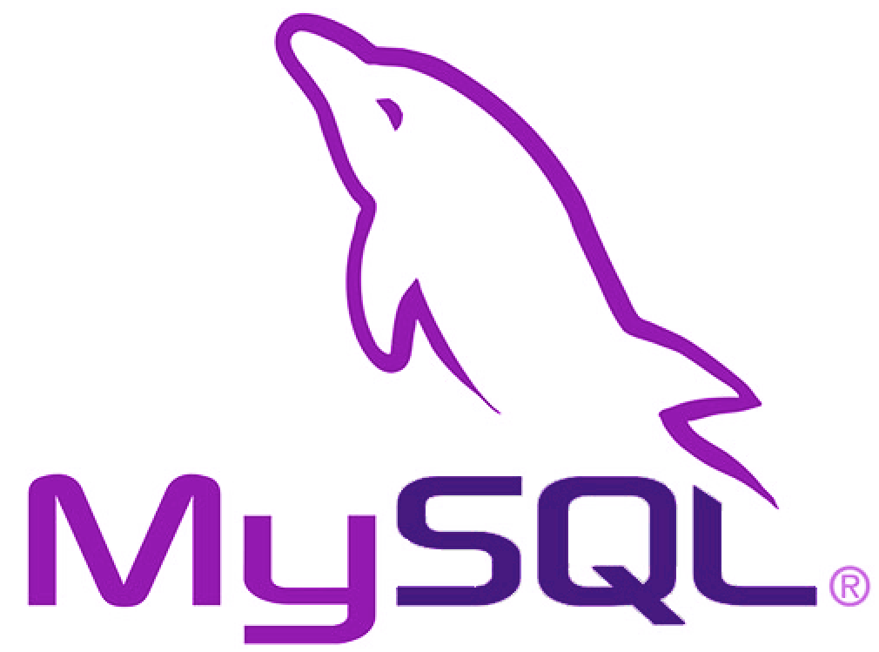






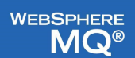

Heterogeneity
Microsoft Azure: Your Open Cloud
Open, broad,
and flexible
Enterprise needs
Languages
Integration
Heterogeneity
CMS
Devices
Databases
DB2
Microsoft Azure fundamentals
On-premises AND cloud
Open, broad,
and flexible
Operating systems
Configuration management
Applications
“We have really made sure that [Azure] is a very open platform. It’s not just about .NET and Windows…we have the most open infrastructure. We want to thrive in this heterogeneous world when it comes to the public cloud.”

Slide 8
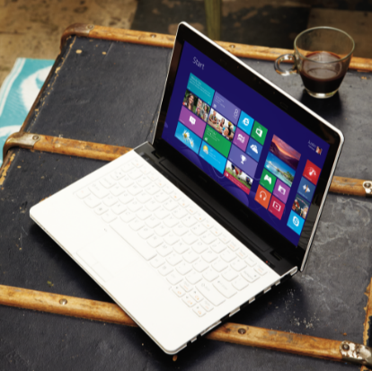
DEMOs
CoreCLR on Linux
Windows Container with Docker
Cross-region MongoDB Replica

Slide 9
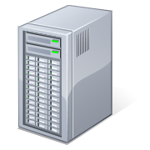
Replica Set
hbai15-mongo-t1.cloudapp.net: 27000
hbai15-mongo-t3.cloudapp.net:27000
hbai15-mongo-t2.cloudapp.net:27000
West US (10.1.0.0/16)
West Europe (10.2.0.0/16)
Primary (10.1.0.4)
Secondary (10.1.0.5)
Secondary (10.2.0.4)
hbai15-mongo-t1 10.1.0.4
hbai15-mongo-t2 10.1.0.5
hbai15-mongo-t3 10.2.0.4
VNet-to-VNet
hbai15-mongo-t1 10.1.0.4
hbai15-mongo-t2 10.1.0.5
hbai15-mongo-t3 10.2.0.4

Slide 10
mongodb-node.sh
Azure Blog Storage
West US (10.0.0.0/16)
custom script extension
10.0.0.4 mongoh
10.0.0.5 mongom
10.0.0.6 mongor
Azure CLI
create.sh
Replica Set

Slide 11
Why Use OSS on Azure

Slide 12
Why Run Oss on Azure…
Scalable, Enterprise Grade & Secure
Azure Templates support for IaaS

Slide 13
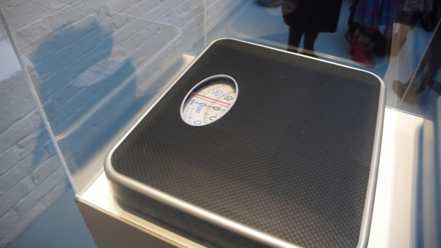


Hyper-Scale
Hyper-scale
Enterprise
Grade
Hybrid
Enterprise Grade
Hybrid
Azure Cloud

Slide 14


Trust and Control
Physical
Infrastructure
Physical
Cameras / Alarms
Infrastructure
Secure By Design
24X7 security staff
Operation Security Controls
Barriers / Fencing
Compliance Certifications
Two-factor access control
Network
Penetration Testing
Days of backup power
Forensics
VM
Network
VM
Secure and Isolated VNets
Anti-Malware
Network ACLs
VM Security Extensions
Azure Active Directory
Role-Based Access Controls
Security Appliances
Logging / Auditing
Multiple virtual NICs
Key Vault and Encryption

Slide 15
Resource Groups
Tightly coupled containers of multiple resources of similar or different types
Lifecycle, Access, Billing & Identity control the resources placed in a resource group
Spans multiple regions
RESOU
R
CE G
R
OUP

Slide 16
Power of Repeatability
SQL-A
Instantiation of repeatable config.
Configuration → Resource Group
Azure Templates can:
Ensure Idempotency
Simplify Orchestration
Simplify Roll-back
Provide Cross-Resource Configuration and Update Support
Azure Templates are:
Source file, checked-in
Specifies resources and dependencies (VMs, WebSites, DBs) and connections (config, LB sets)
Parametized input/output
Website
[SQL CONFIG] VM (2x)
DEPENDS ON SQL
DEPENDS ON SQL
SQL - A
Website
Virtual
Machines
SQL
C
ONFIG

Slide 17
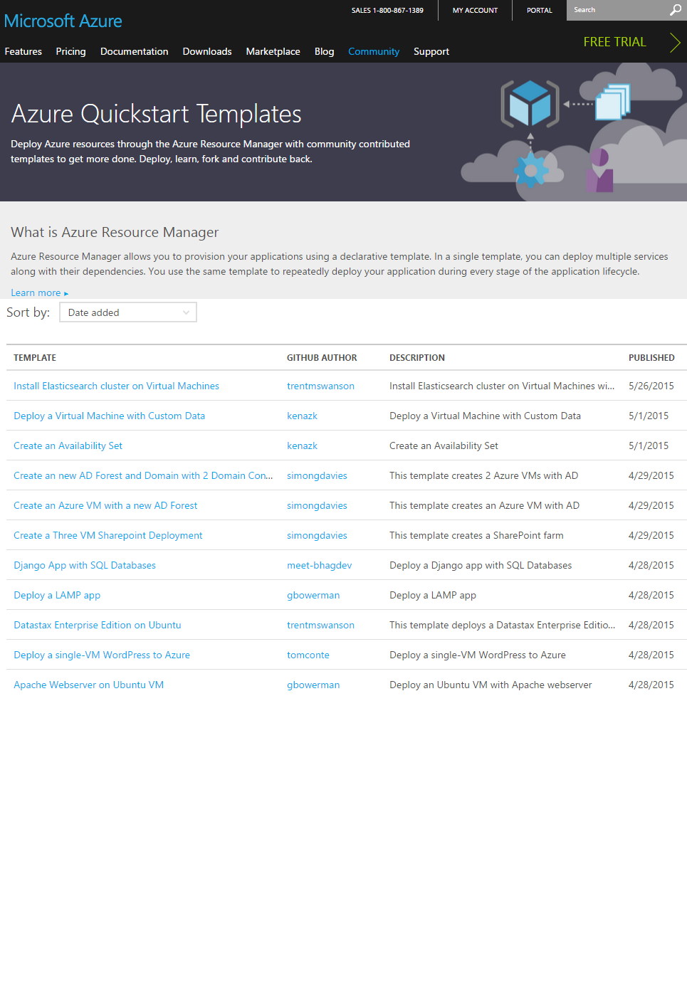
Azure Templates for IaaS Stack
Complexity made Simple – Build, integrate and deploy complex applications with ease using Azure Templates
Build applications using IaaS & PaaS Azure Services in a single Template (For Example: Websites + VM)
Easily Scalable Deployments using Copy & CopyIndex (Loops) in Azure RM
Role-Based Access Control support
Tags Configuration and billing propagation to the monthly usage bill

Slide 18
DEMOs
Deploy <> on Azure

Slide 19
Sample Scenarios

Slide 20
Sample scenarios
LAMP

Slide 21
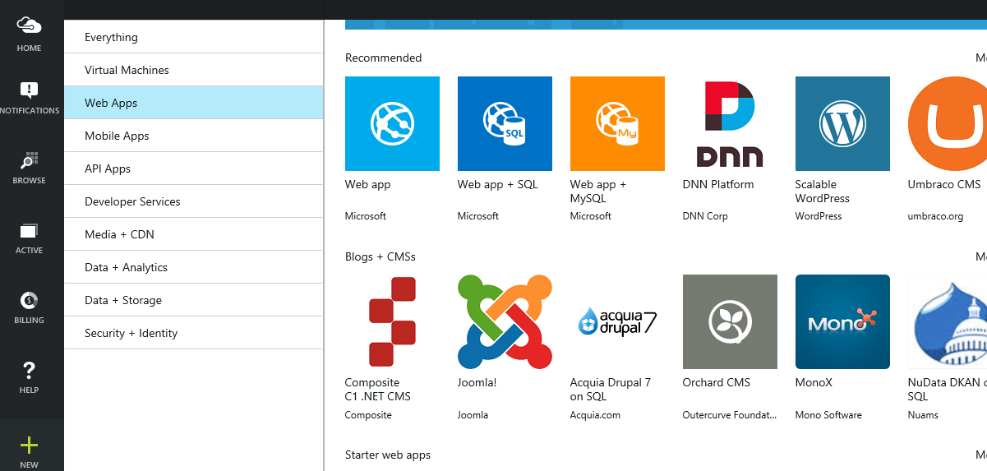
Web Apps

Slide 22
VM Depot
Azure VM Images
Community managed
Linux and FreeBSD images
Deploy from VM depot
Deployment scripts and tutorials
Over 1000 images
http://aka.ms/vmdepot

Slide 23
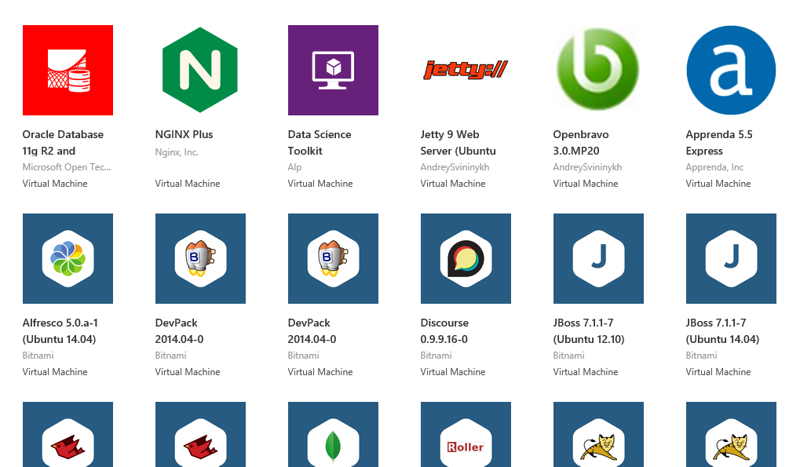

Slide 24
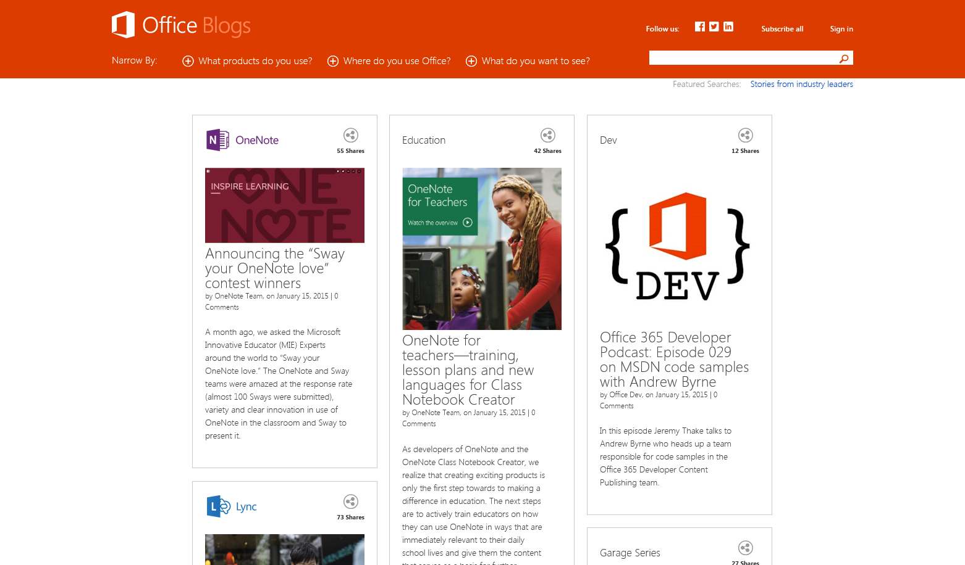
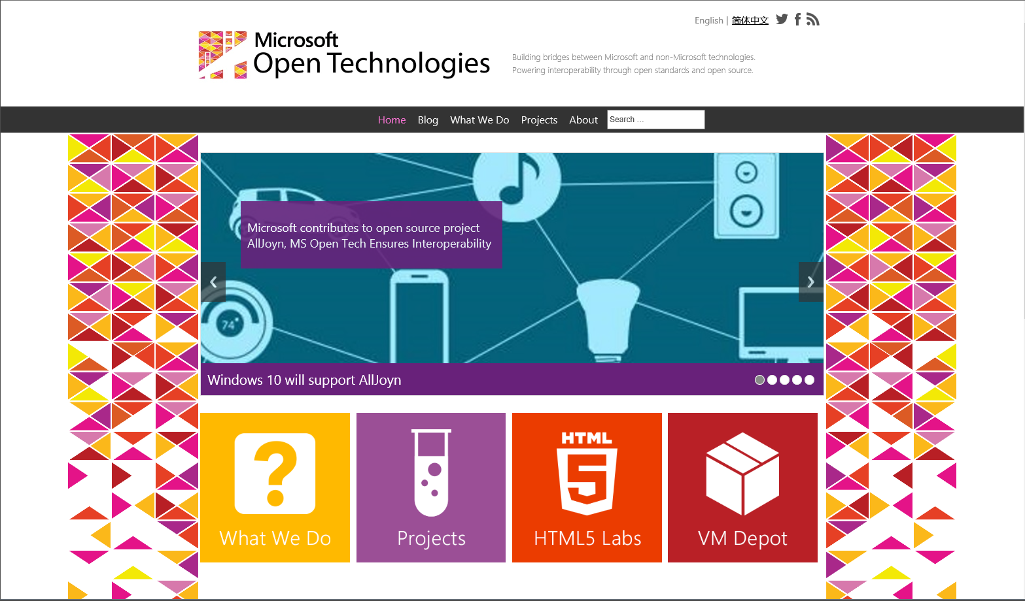
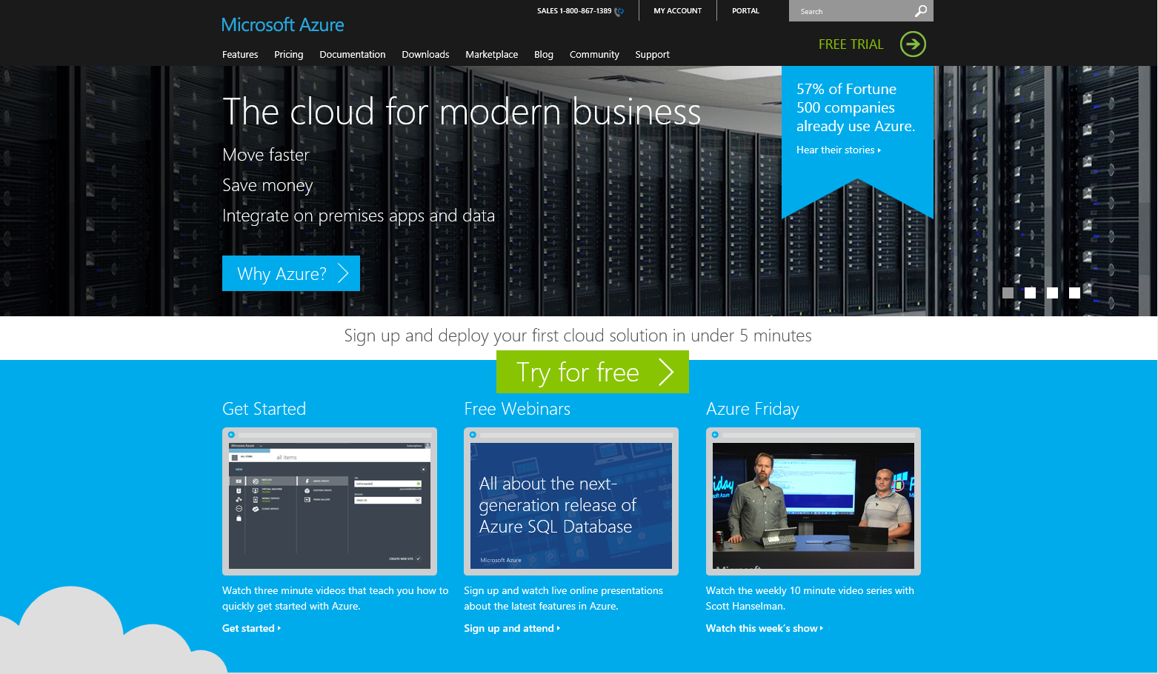
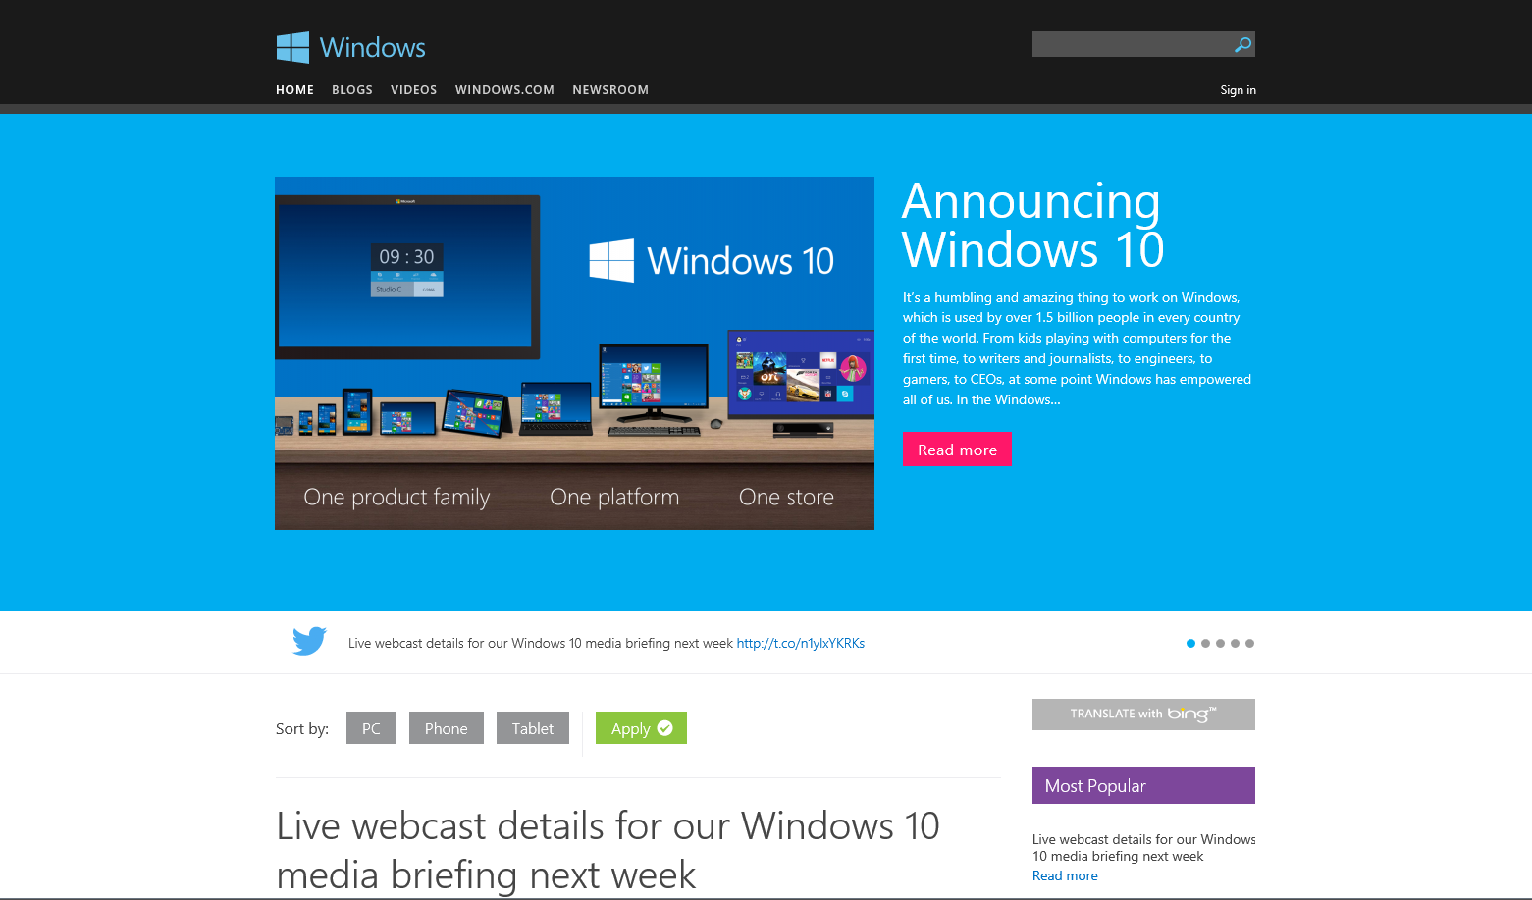
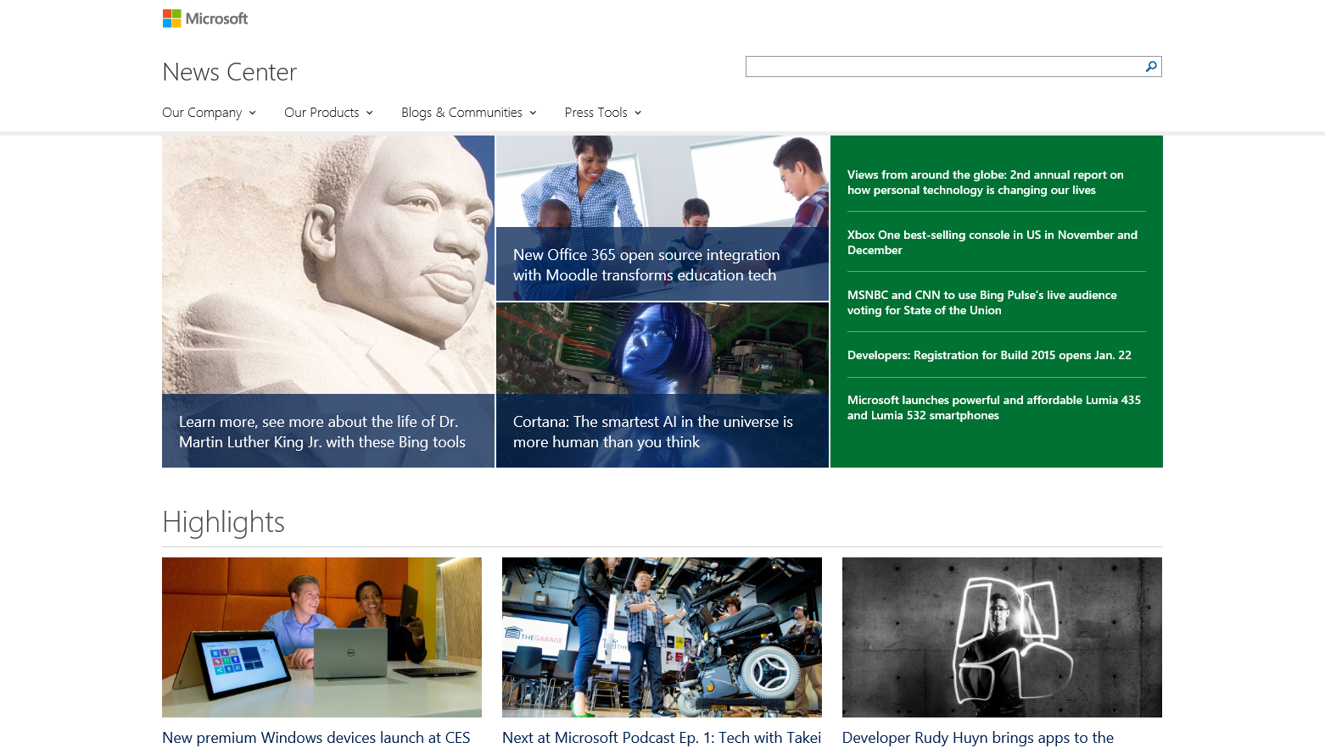
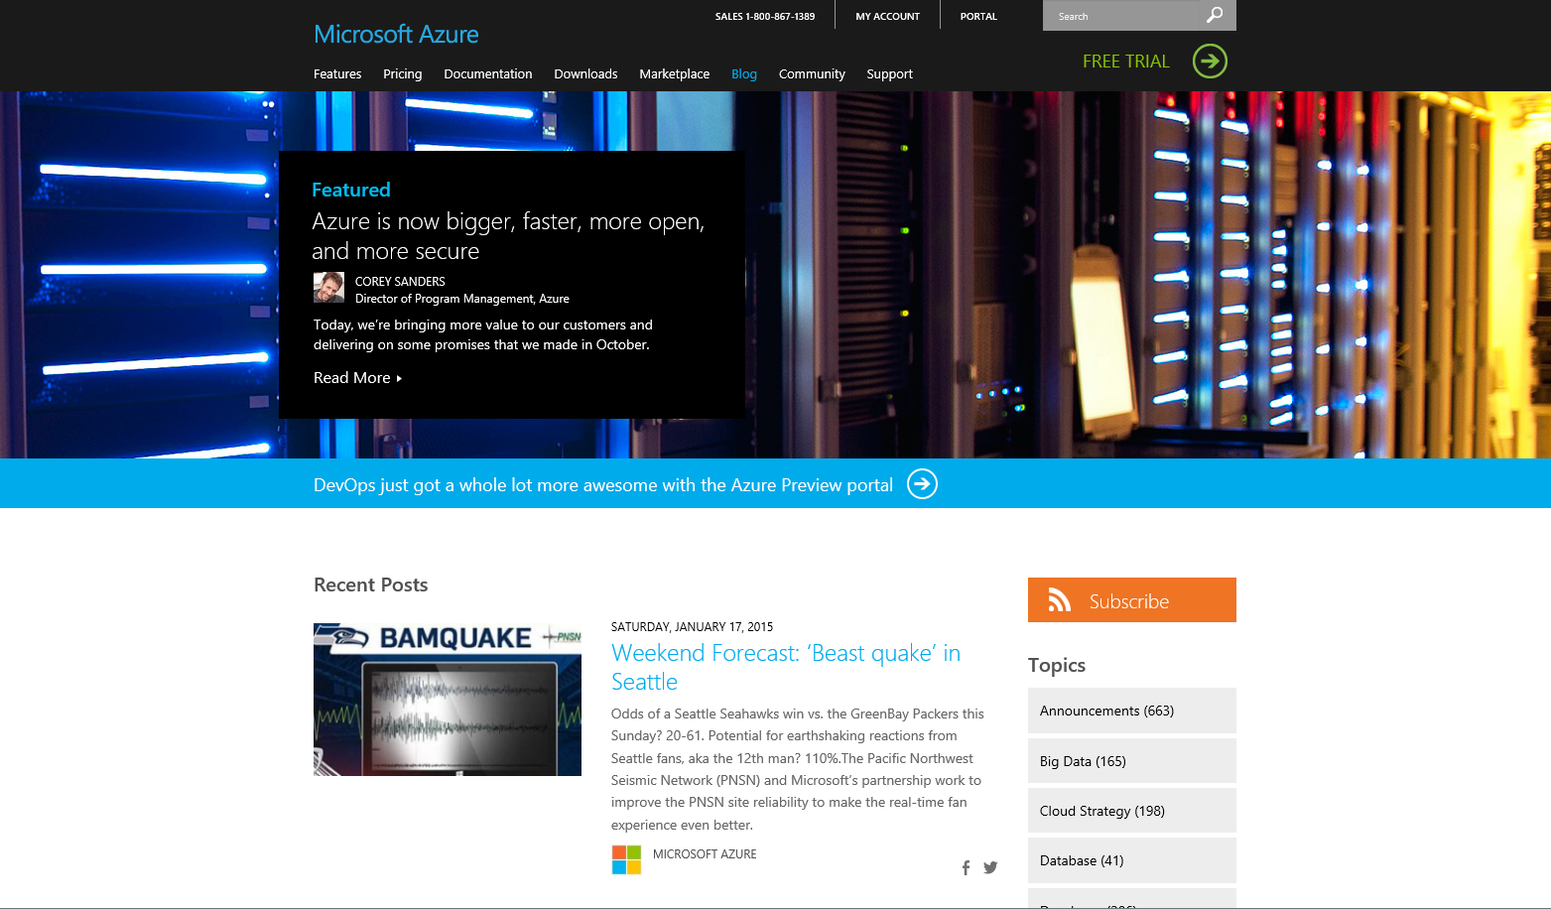
Microsoft Runs Mission Critical WordPress Apps on Azure

Slide 25
DEMOs
Deploying WordPress on Azure via Web Apps and VM Depot

Slide 26
Azure Toolkit for Eclipse
Test with Azure Emulator
SSL
Sticky Sessions
Configure your roles
Instance count
Size
Endpoints
Names
Self-Signed Certs for testing
Publish to Azure

Slide 27
MS Open Tech Tools Plugin for IntelliJ
Limited Java functionality compared to the Eclipse Toolkit
Test using Azure Emulator, deploy to Azure
Configure deployment components for more advanced deployment configurations
Configure Azure storage accounts for your deployments to use
Enable sticky sessions (session affinity)
Add additional Java applications to your deployment (as WAR files)

Slide 28
DEMOs
Deploying a Tomcat Java App to Cloud Services

Slide 29
Sample Scenarios

Slide 30
Sample scenarios
Big Data

Slide 31











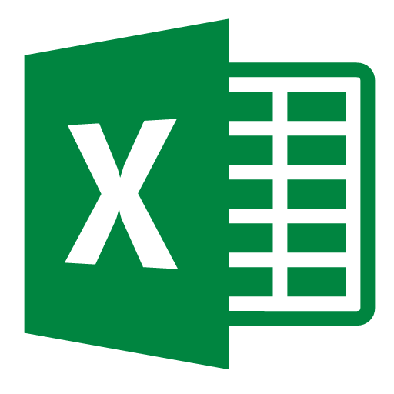












Produce
Collect
Ingress
Transform
Store
Present
Act
Application
Connectors
Event Hubs
Stream Analytics
Azure Storage
Power BI
Devices
Sensors
Cloud gateways
ActiveMQ
Machine Learning
HBase
Excel
Social
Web / Search
Field gateways
RabbitMQ
HDInsight
SQL Database
Dashboards
Tags
Sensor networks
Kafka
Storm
Redis
Mobile

Slide 32
Selected customer scenarios
Scenario | Input | Operators (Examples) | Side Lookup | Output | Programming Language
Connected Cars | Event Hubs | Window-based aggregation, join stream / split stream | HBase, ML | DocumentDB | C# hybrid, Java
ETL | Event Hubs | Partitioning / organize | N/A | WASB | Java
IoT | Event Hubs | Window-based aggregation | Hbase, ML | DocumentDB, Hbase | Java
Fraud Detection | Service Bus Queue | Filter | ML | HBase | C# hybrid
Social Analysis | Twitter | Group-by / trending topics | N/A | Realtime Dashboard (BI) | Trident
Network Monitoring | Kafka | Split (on success / failure) | ML | SQL | C# hybrid
Log Search | Storage Queue / Event Hubs | Parsing & index | N/A | Elastic Search | Java
Mobile Engagement | Event Hubs | Count | HBase | SignalR | C# hybrid

Slide 33
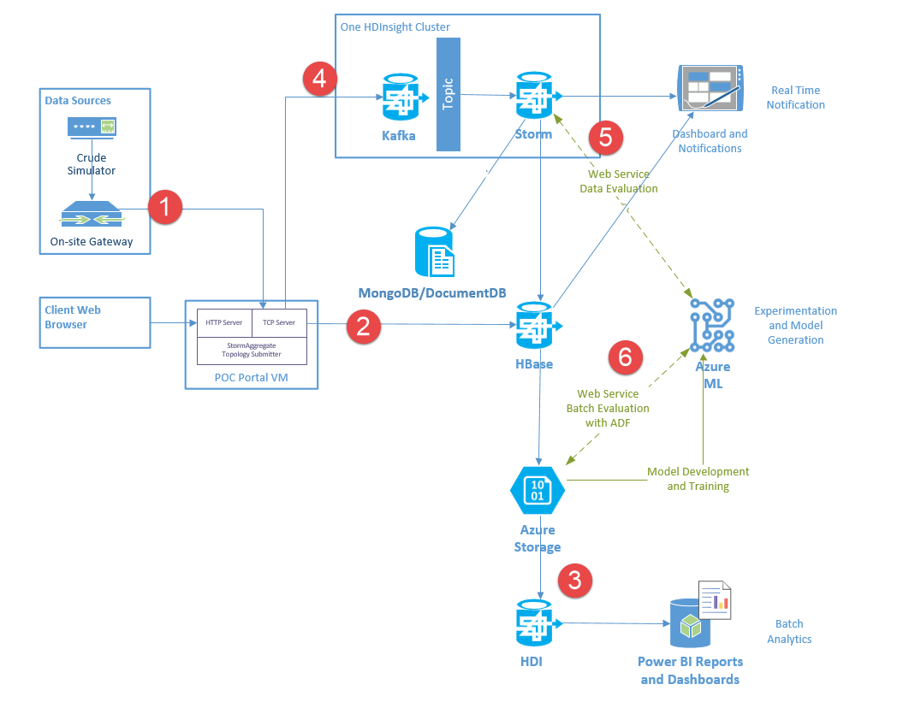
Emerson

Slide 34
DEMOs
Kafka with HDInight

Slide 35
Sample Scenarios

Slide 36
Sample scenarios
Internet of Things

Slide 37

OPC Virtual Compatibility Lab Architecture
OPC Server/Client
OPC Test DB
DC
HTTP
RDP endpoint
OPC Server endpoint
VPN
VPN
Test Lab Client
On-premises OPC Server/Client

Slide 38



OPC Connector-Azure Integration
Produce
Collect
Ingress
Transform
Store
Present and Action
Mobile
HDInsight
Event Hub
OPC Connector
OPC
AMQP
OPC Data Analysis Service (ODAS)
Web
Redis
On-premises OPC Server
Storage Adapters
Batch Processes
API
Azure Search
Azure Storage
Azure Machine Learning
Other data sources
Other data sources

Slide 39
DEMOs
OPC Foundation on Azure

Slide 40
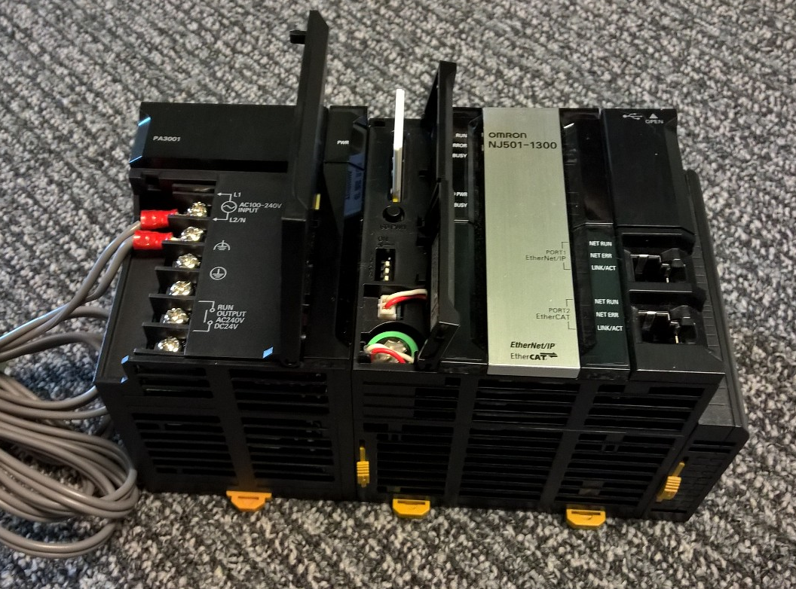

Slide 41
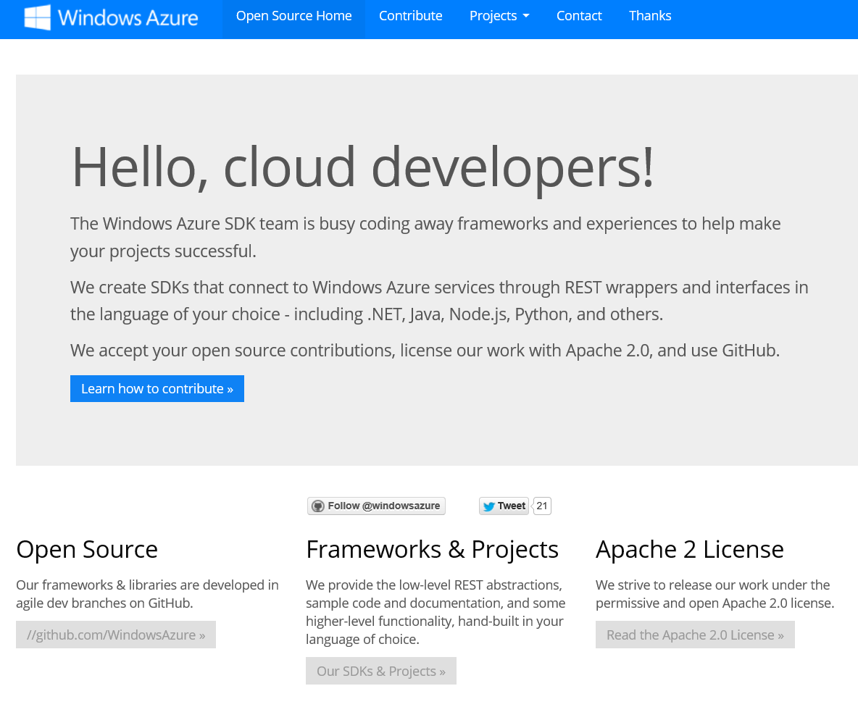
azure.github.com

Slide 42
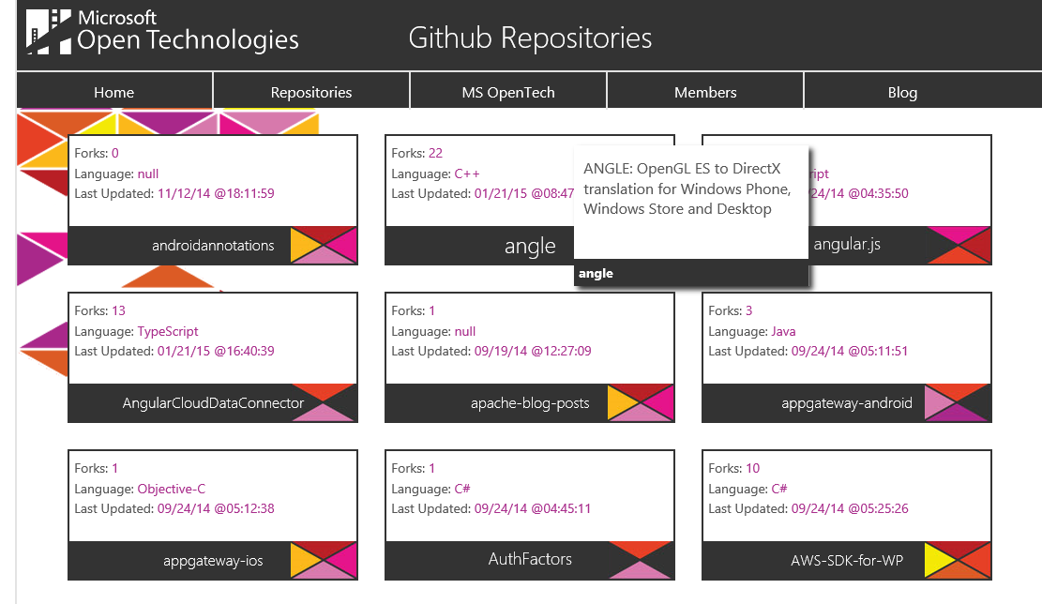
msopentech.github.com

Slide 43
Resources
Improve your skills by enrolling in our free cloud development courses at the Microsoft Virtual Academy.
Try Microsoft Azure for free and deploy your first cloud solution in under 5 minutes!
Easily build web and mobile apps for any platform with AzureAppService for free.

